Slide 1
Digital Neural Signal Processing
Theo Zanos
Dept. Of Neurology & Neurosurgery Montreal Neurological Institute
McGill University

Slide 2
Contact Info
Office: Montreal Neurological Institute 3801 University Street, #894
Tel: 5482
Email: theodoros.zanos@mcgill.ca

Slide 3
Overview of the class
Neuronal Oscillations
What is an Oscillation - How are neuronal oscillations created
Frequency, Phase and Power
Fourier Transform – DFT – FFT
Wavelets – CWT – Interpretation
Brain Connectivity through synchronicity
Correlation
Coherence
Phase Coherence
Granger Causality

Slide 4
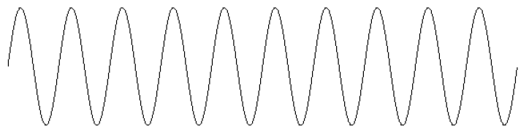
Oscillations
What is an oscillation
Definition: sin (2*pi*freq*time)

Slide 5
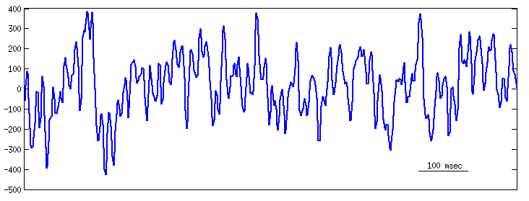
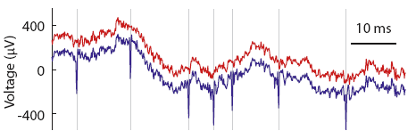
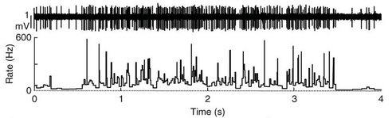
Neuronal Oscillations
Continuous Neural Data (not point processes)
Firing Rate Data
Extracellular recordings (raw wideband)
Local Field Potentials - LFPs (low frequency filtered version of extracellular recordings)
Electroencephalography signals – EEGs
Electrocorticography – ECOG
MEG, fMRI etc.
Goldberg & Fee, Nat Neurosci. 2012

Slide 6
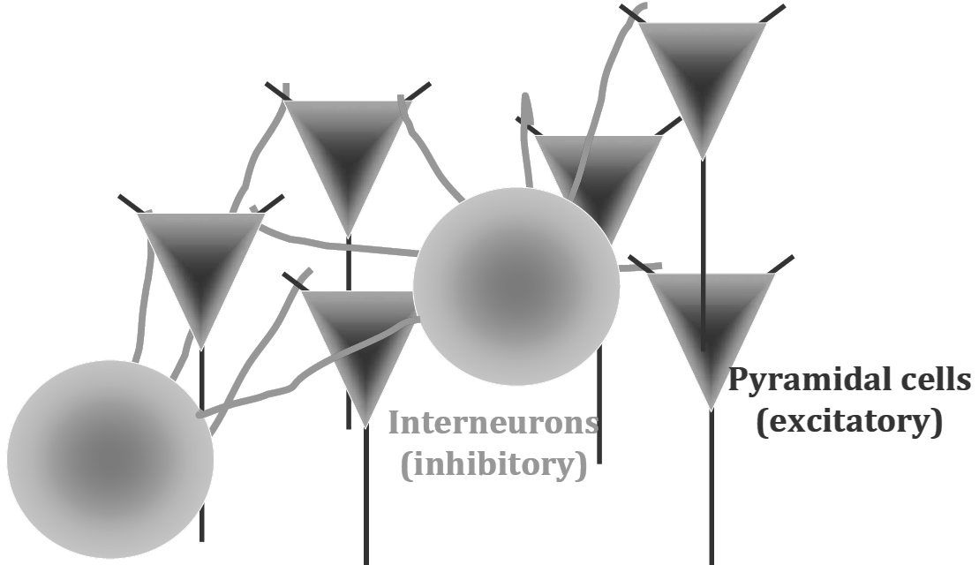
What causes LFP / ECoG / EEG Oscillations

Slide 7
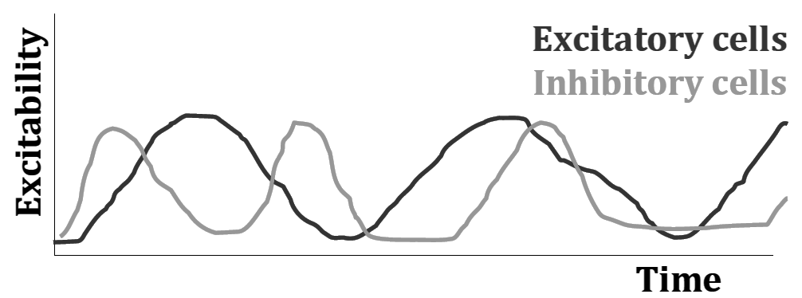
What causes LFP / ECoG / EEG Oscillations
Oscillations arise from the interplay between inhibitory interneurons and excitatory cells (EPSPs vs IPSPs)
Inter and intra-areal network activity, feed-forward and feed-back connections.
Subthreshold potentials of nearby neurons (LFPs only)

Slide 8
A typical LFP signal

Slide 9
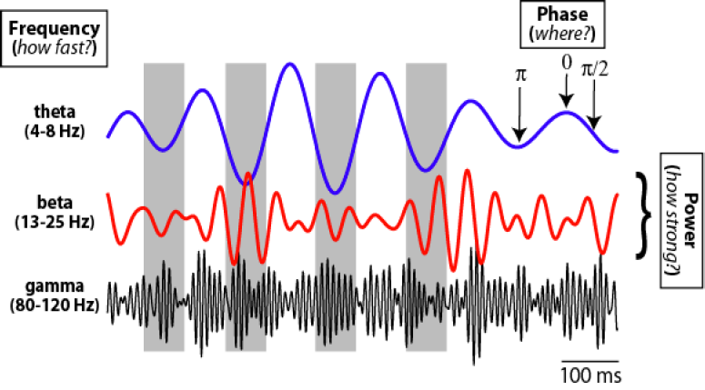
Frequency – Phase - Power

Slide 10
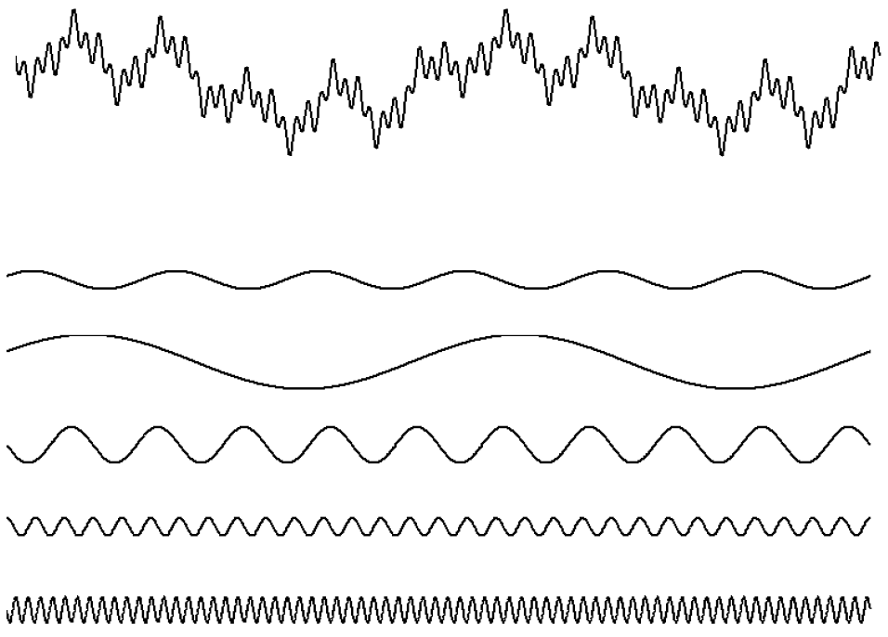
Fourier Transform
Any signal can be expressed as a combination of different sine waves, each with its own frequency, amplitude and phase

Slide 11
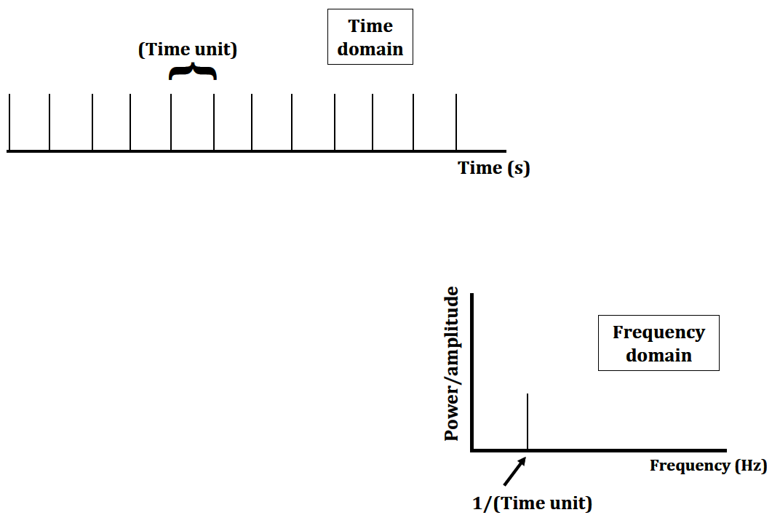
From time to frequency domain

Slide 12

Fourier Transform
Mathematical definition
Euler’s formula
e^{2πiθ}= cos(2πθ) + i sin(2πθ)

Slide 13
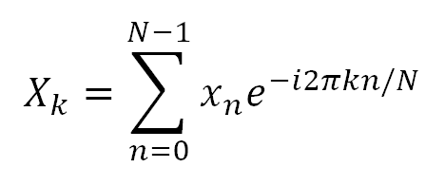
Discrete Fourier Transform (DFT)
For digitally sampled signals there’s DFT
Mathematical definition (for N points)
Frequency k/N Hz per sample
Amplitude
Phase

Slide 14
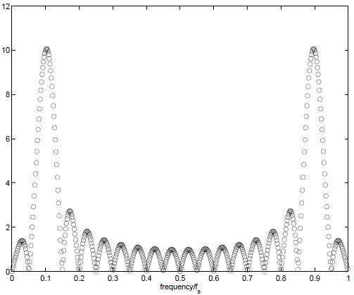
Discrete Fourier Transform (DFT)
DFT is symmetric around center point f_{s} /2

Slide 15
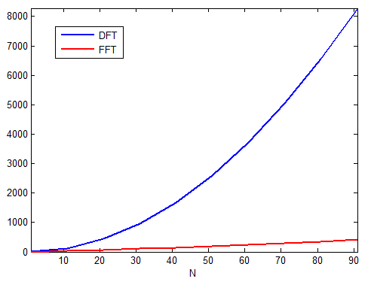
Fast Fourier Transform (FFT)
Algorithm used to compute DFT efficiently
For N points, DFT scales O(N²)
With FFT, the process scales Nlog(N)

Slide 16
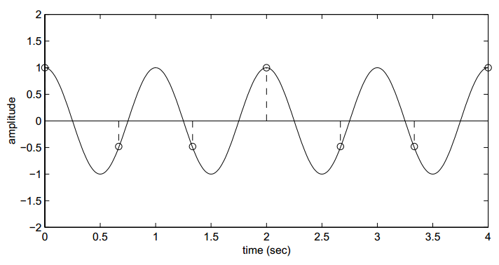
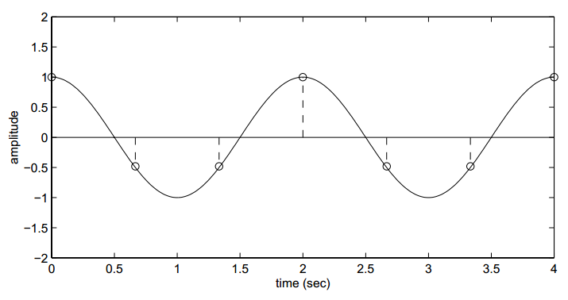
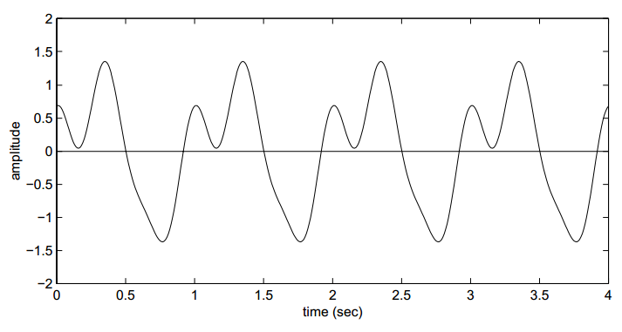
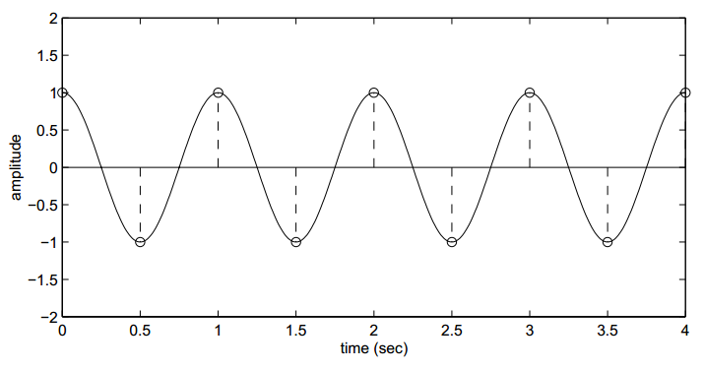

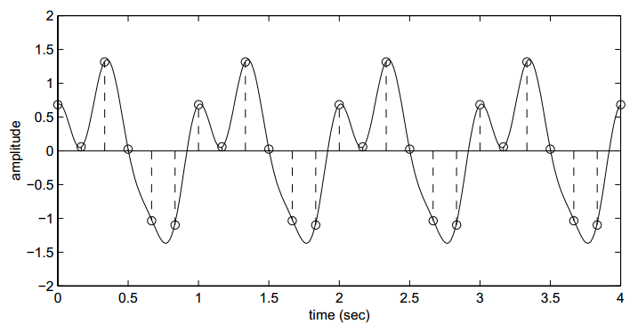
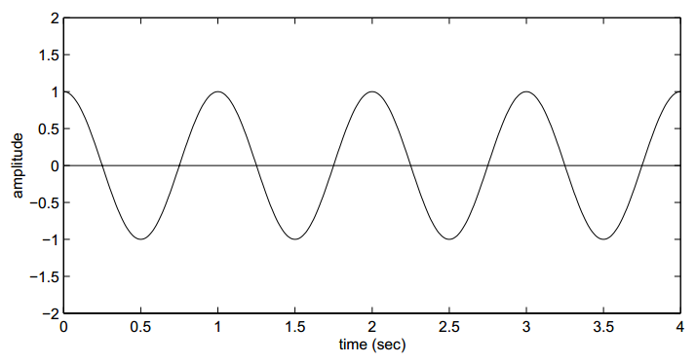
Nyquist Theorem
The sampling frequency should be at least twice the highest frequency contained in the signal
f_{s}≥f_{c}

Slide 17
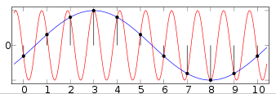
Aliasing
Signal frequencies higher than the Nyquist frequency will encounter a "folding" about the Nyquist frequency, back into lower frequencies.
f_{folded} = |f_{sampling} – N·f_{signal}|, N≠0
Example: Signal has a frequency of 0.9Hz
We sample at a frequency of 1Hz.
Folded frequency will appear at 0.1Hz.

Slide 18
Filtering – quick overview
Using filters (analog or digital) we can remove frequencies from a certain signal
Low pass
High pass
Band pass
Band stop (notch filter)
Every filter has a phase response (while filtering, it shifts the oscillations of the signal according to the phase response of the filter)
To account for that, double-pass filter (filtfilt command)

Slide 19
Stationarity
In signal processing, stationarity denotes that the signal does not change it’s frequency content across time
Thus the DFT is an adequate way to represent the signal in the frequency domain and using IDFT, we can reconstruct the signal from it’s spectrum
What happens with non-stationary signals?

Slide 20


Short-Time Fourier Transform (STFT)
Using a sliding window in time, STFT calculates the Fourier transform of these snippets of time
For the DFT equivalent (STDFT)
Spectrogram is the squared magnitude of STFT
Choice of length and type of window is critical

Slide 21
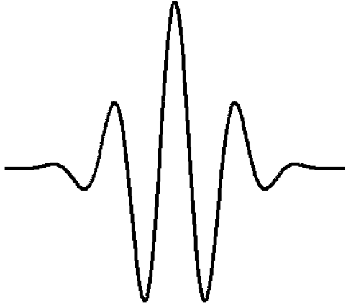
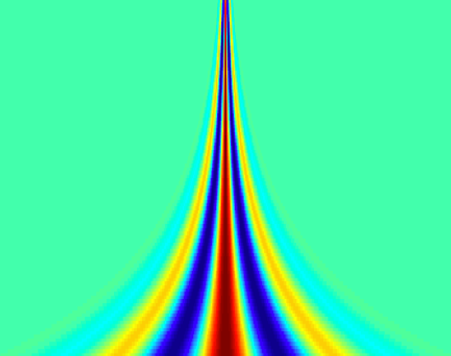
Wavelets

Slide 22
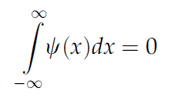
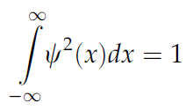
Wavelets
Two criteria for the wavelet function ψ(x)
( (equal area above and below zero)
(square integrable – converges to zero at infinity)

Slide 23
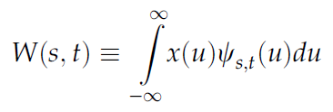
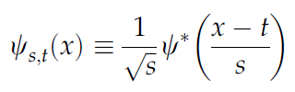
Continuous Wavelet Transform (CWT)
Mathematical Definition
where t is time and s is scale (analogous to f)
s is for scaling, t is for translating (shifting)

Slide 24
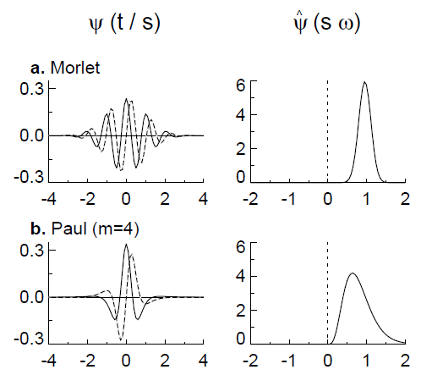

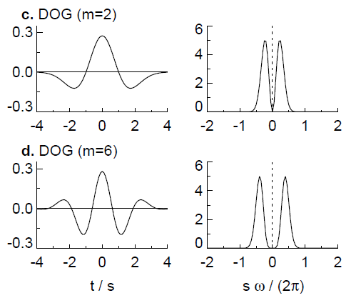
Choosing wavelet functions

Slide 25
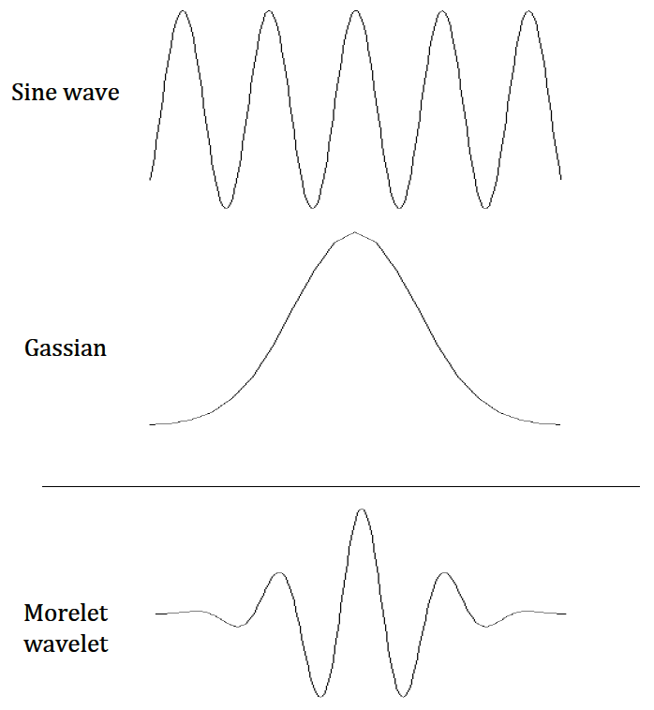
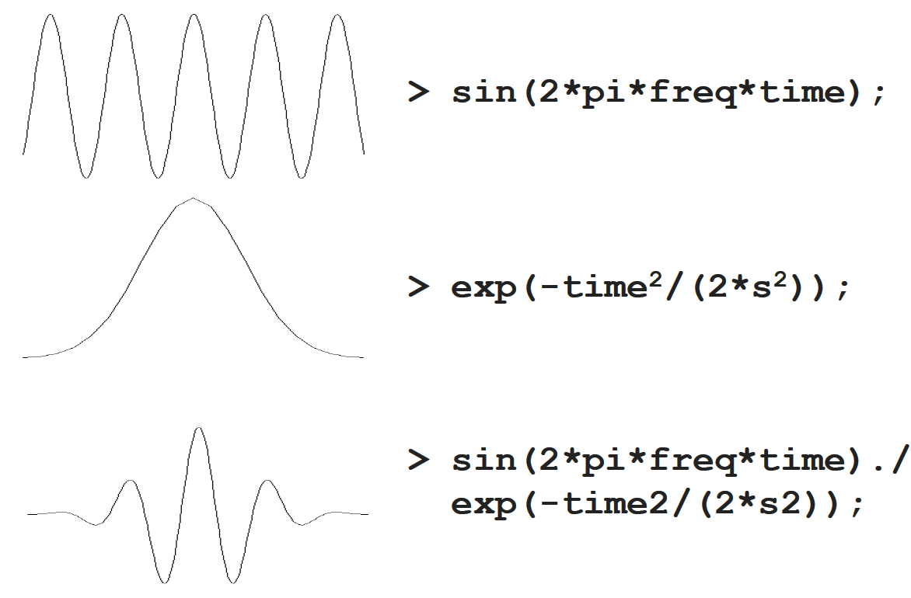
Morlet Wavelet Origins

Slide 26
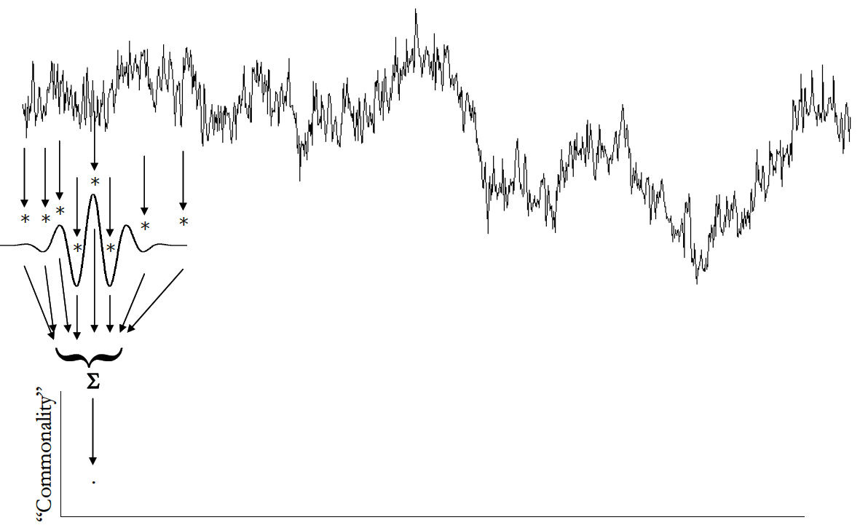
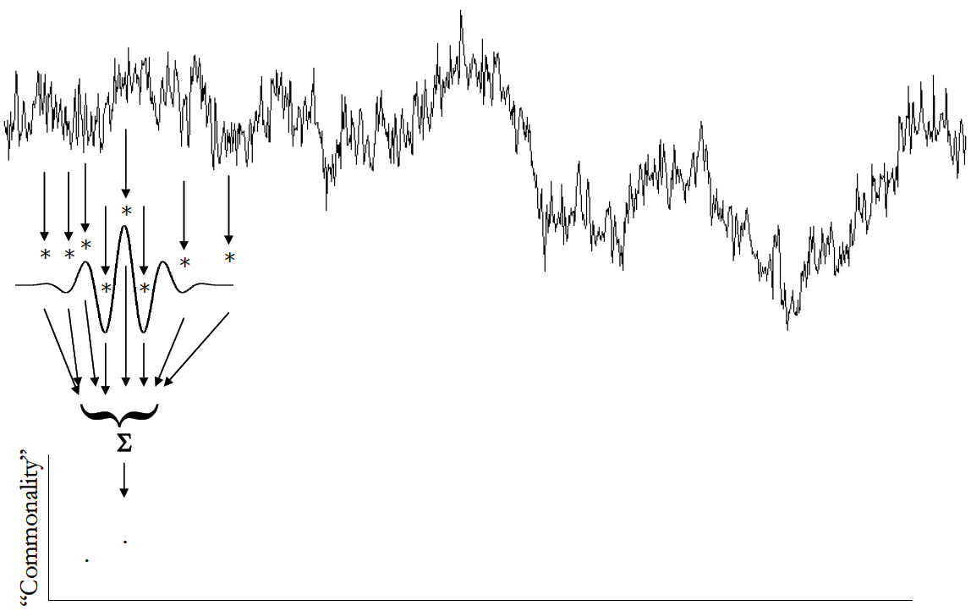
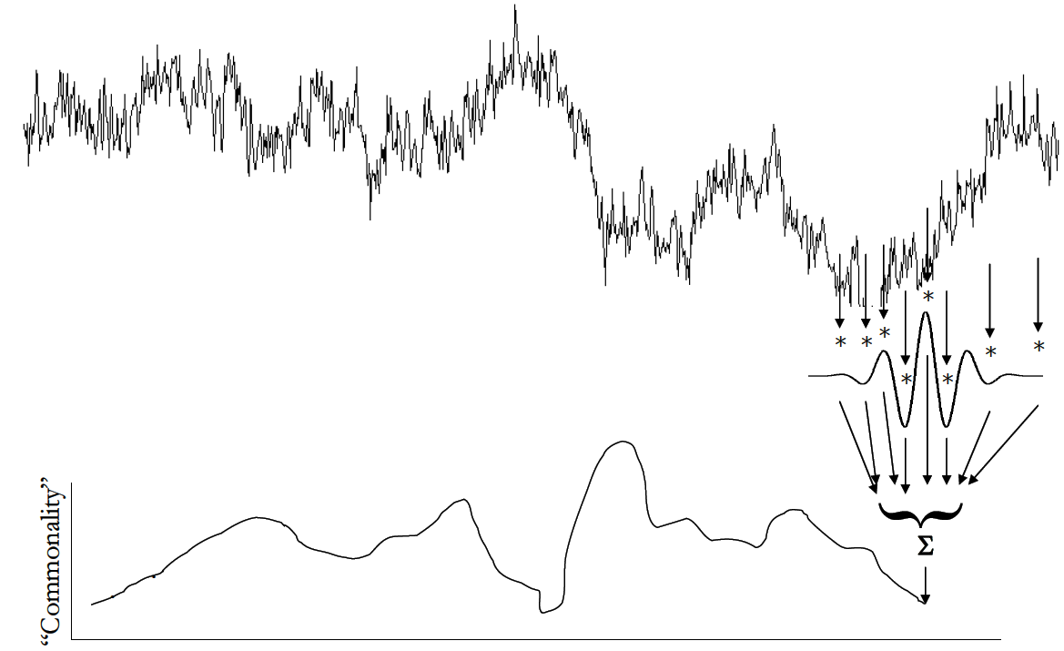
Convolution with a wavelet

Slide 27
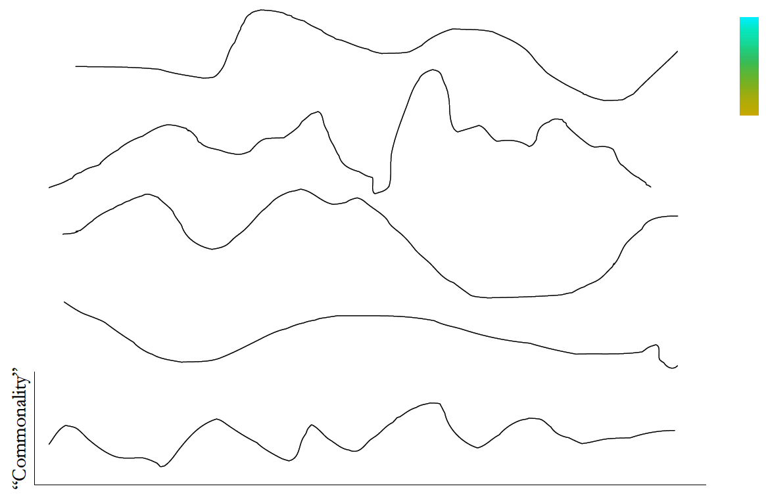
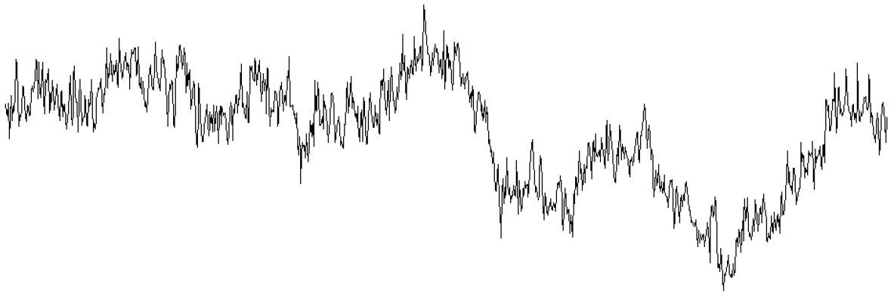
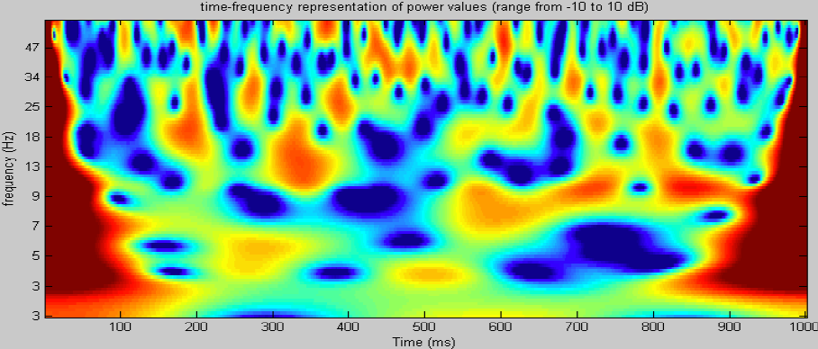
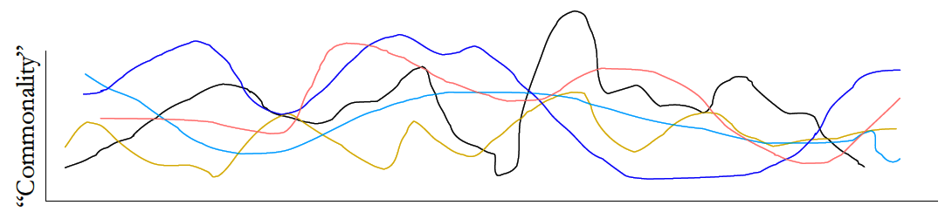
Wavelets and convolution

Slide 28
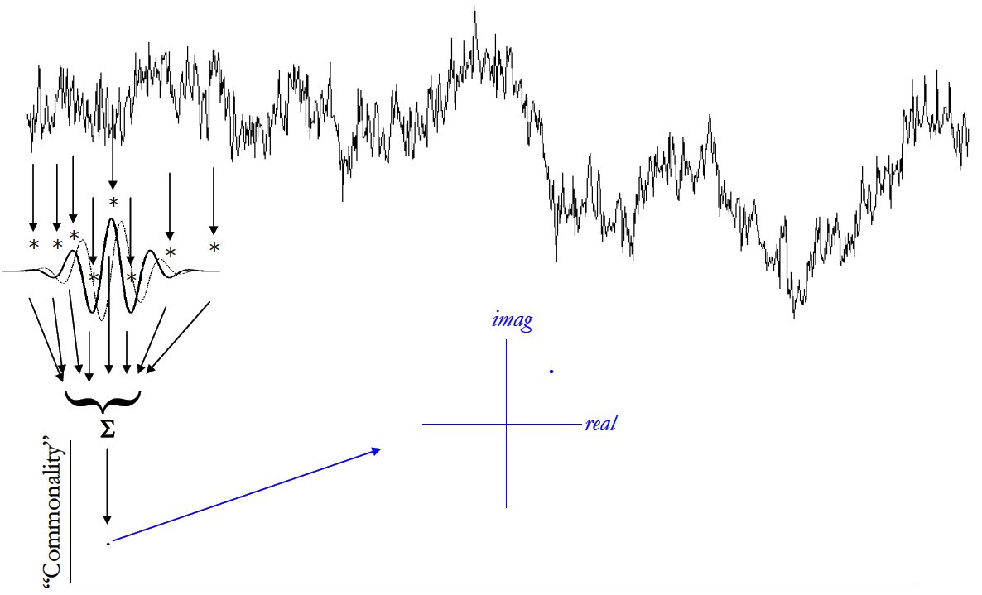
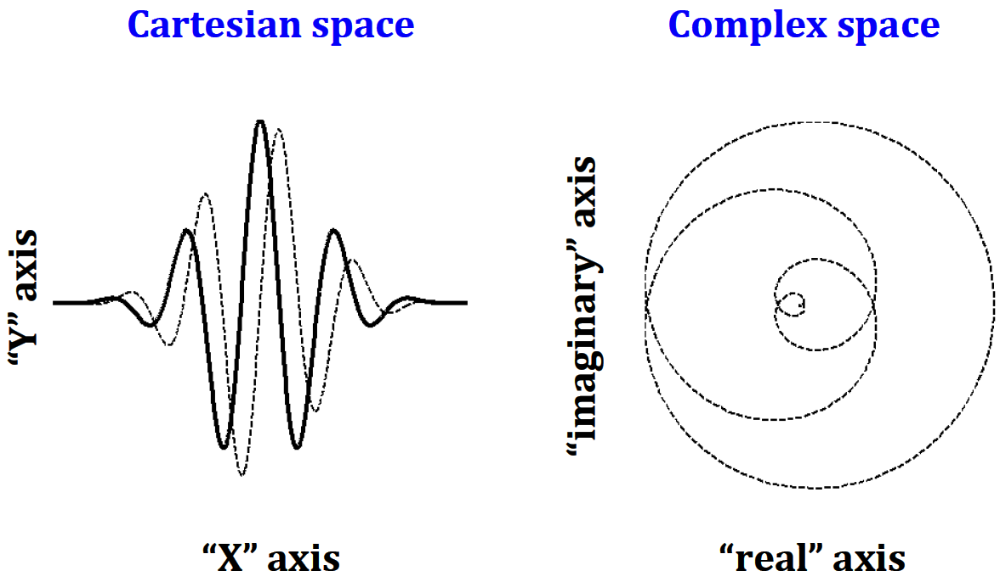
CWT – the complex part of it

Slide 29
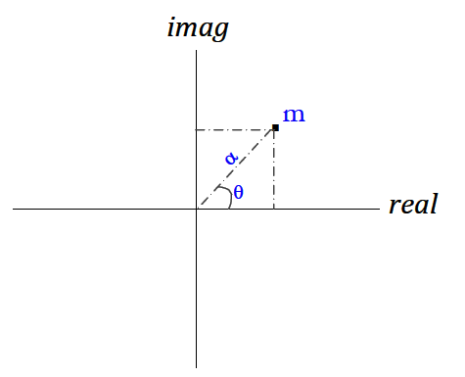
Power and Phase information through Wavelets
Real part of the vector : Filtered LFP at the specific frequency
Length of vector m: Magnitude at the specific frequency
Angle θ : Instantaneous phase at the specific frequency
m = sqrt(real^2+imag^2) θ = arctan(imag/real)

Slide 30
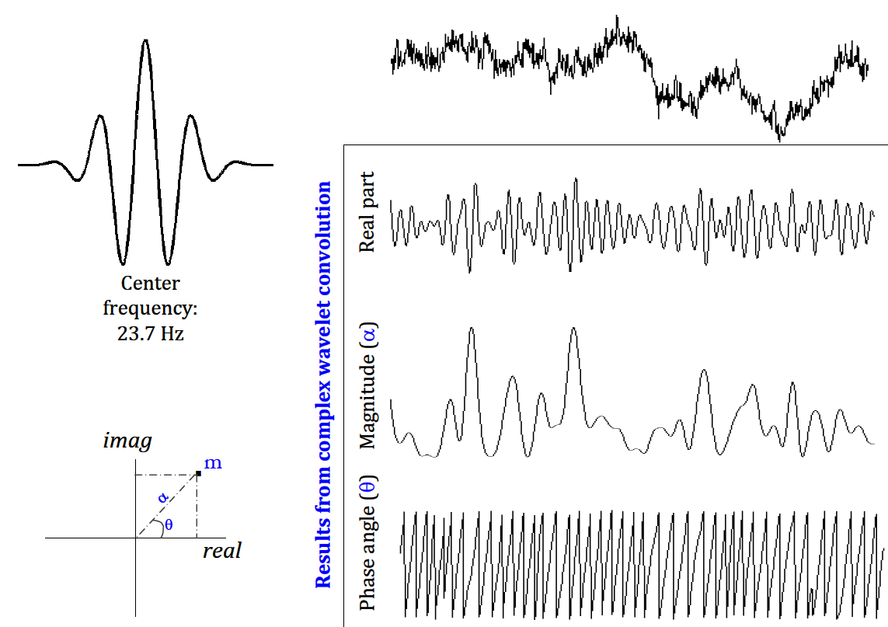
Results of a CWT

Slide 31
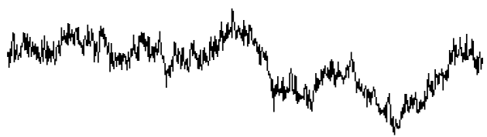
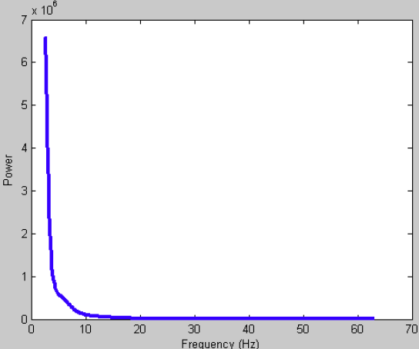
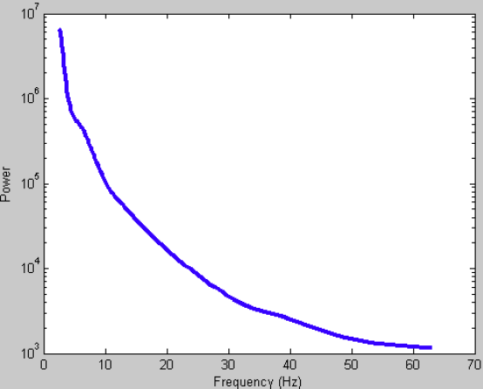
Power Law
Power decreases with increasing frequency
At low frequencies, power approaches a 1/f function
Log scale
Linear scale

Slide 32
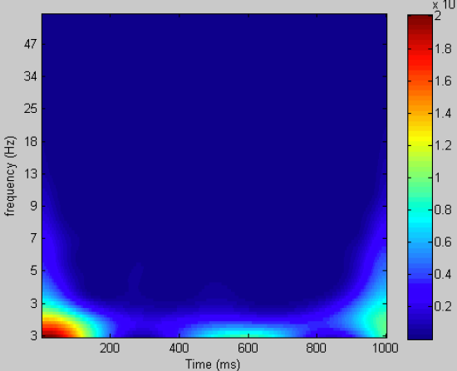
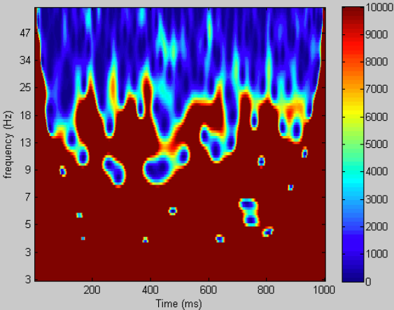
Power law
Possible effects in higher frequencies will be nearly impossible to see when plotted on the same scale as low frequencies
Colorscale for all frequencies
Colorscale optimized for high frequencies

Slide 33
Power normalization
Baseline vector
Depends on what is considered baseline
Average of all wavelet coeffs during the whole recording
Pre-stimulus wavelet coeffs
Average wavelet coeffs of spontaneous activity
dB ratio (scale-free)
dB = 10*log10(activity/baseline)

Slide 34
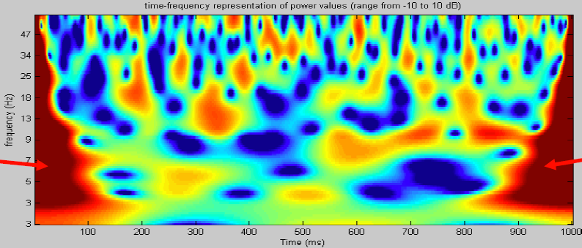
dB Scaling – Edge Artifacts

Slide 35
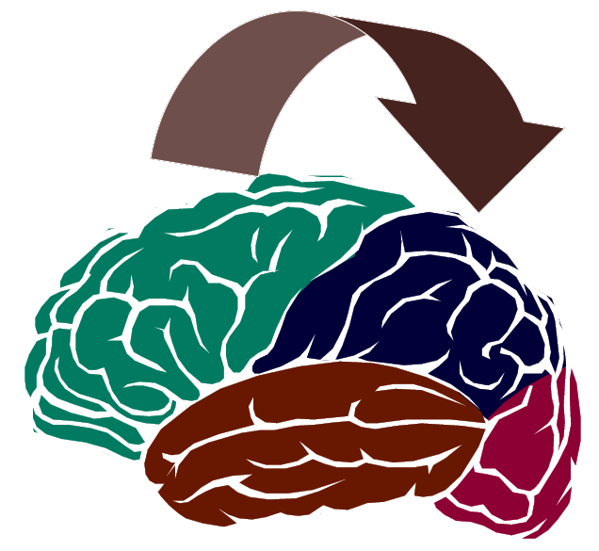
Brain Connectivity through synchronicity
How do different brain regions connect and communicate?
Hebb – “Cells that fire together, wire together”
For oscillations, “areas that oscillate together, are connected”
Synchronous oscillations

Slide 36
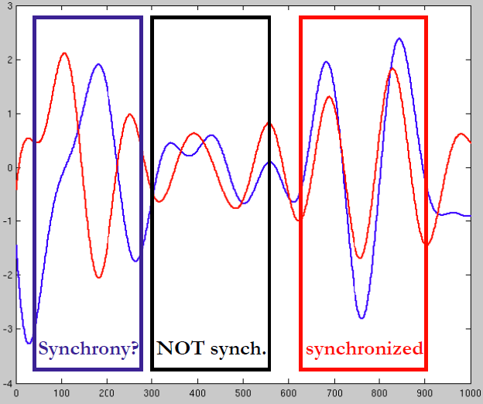
Synchronicity
Synchronous oscillations – an intuitive concept but how can you measure it quantitatively?

Slide 37


Correlation
For continuous functions
For discrete functions
Convolution between f(t) and g(-t)
Not necessarily good for oscillatory data

Slide 38


Power Spectral Density
Energy Spectral Density for transient signals
Power Spectral Density for continuous signals
where
Relating it to the FT
Sxx = F_{x}(ω) F*_{x}(ω)
where F_{x}(ω) is the Fourier Transform of x and * is the complex conjugate FT of x

Slide 39

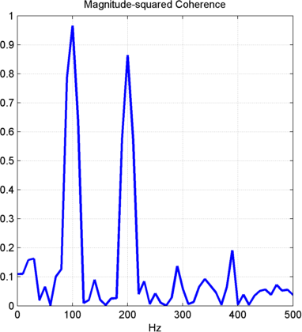

Coherence
Cross Spectrum between two signals
where F_{x}(ω) is the Fourier Transform of x and F*_{y}(ω) is the complex conjugate FT of y
Magnitude Square Coherence

Slide 40
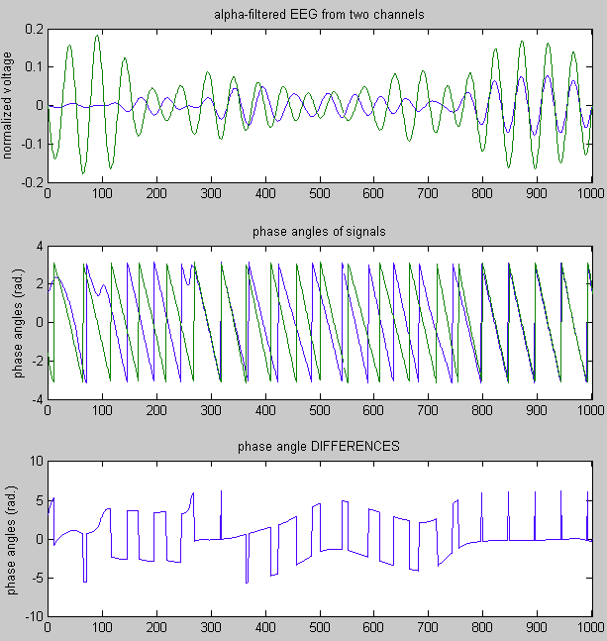

Phase Coherence
Electrodes A and B
Electrodes A and C

Slide 41


Phase Coherence
Electrodes A and B
Electrodes A and C
Phase Coherence = 0.11
Phase Coherence = 0.94
Magnitude of average vector from
polar phase difference histograms

Slide 42

Phase Coherence
The equation is fairly simple
Can be used for specific frequency bands

Slide 43
Granger Causality
Causality implies directional measure of connectivity
Granger causality measures whether signal X happens before signal Y and helps predict it
Steps
Develop a base case autoregressive model for Y using Y’s lagged balues
Develop a test case model by adding a second lagged independent variable you want to test (signal X)
Calculate the square of the residual errors for the two models and run an t-test (unpaired) or an F-test to check if the residuals are significantly lower when you add the second test variable.

Slide 44

Granger Causality

Slide 45

Granger Causality
AR Model
Linear method
Directional
Causality or connectivity assessed with such metrics does not necessarily means real connectivity

Slide 46
Volterra Functional Connectivity (shameless self promotion)
Non-linear measure of connectivity
Versatile with both continuous or point process data
Computationally much more tractable than nonlinear Granger causality or information theory based methods
Similar idea with GC – expanded to account nonlinearities and multiple inputs

Slide 47


Volterra Functional Connectivity

Slide 48
Volterra Functional Connectivity
Measure of prediction accuracy depends on the data’s nature
ROC-AUC for point processes
NMSE for continuous data
Constructed model that predicts signal y from signal x is compared with random predictor models (using as input surrogate signals x_{r} with similar structure as x) and Monte-Carlo runs that establish a 95% or 99% confidence
For more details, check Zanos et al. IEEE Trans Neural Engineering 2008.

